Slide 1
6
CYCLE THREE 2022

Slide 2
http://year6homework.weebly.com/

Slide 3
YEAR 6 ENGLISH KNOWLEDGE ORGANISER
KEY VOCABULARY
Prior Knowledge
Features of a diary include – date and time of entry, past tense, first person, describe the writers thoughts and feelings.
Automaton (tier 3)
A handmade machine in the shape of a human that performs a task.
Narrative – stories can be made up of an opening, build-up, dilemma, resolution and ending.
Apprentice (tier 3)
A person who is learning a new skill or trade from an employer
Play scripts include dialogue between characters. Dialogue is used to help move the story forward by creating suspense or action between characters.
Conscience (tier 2)
A person’s moral sense of right or wrong to guide their behaviour and decisions.
Orphan (tier 2)
Someone whose parents have both died. Hugo is an orphan.
STICKY KNOWLEDGE
Grammar Focus
A play script is a piece of writing intended to be performed on stage. That uses the following features: character list, scenes, a setting description before each scene, dialogue and stage directions.
Parenthesis
Horologist (tier 3)
Someone who makes and repairs clocks
Used to show extra information usually marked with a pair of commas, dashes or brackets.
Hugo Cabret (an orphan) lived in Paris.
Intricate (tier 2)
Something that is very complicated and detailed.
Colon
When we take extra information (parenthesis) out of a sentence it still make sense on its own.
A punctuation mark used to introduced items in a list. To fix the clock use the following: cogs, wheels and motors.
Scavenged (tier 2)
Searched for or collected something from discarded waste.
Word Classes
To take something apart or break it into pieces.
Semi colons are a good way to join two main clauses in a sentence that link ideas together.
The category or group a word belongs to.
Paris = noun
Mysterious = adjective
Disassembled (tier 2)

Slide 4
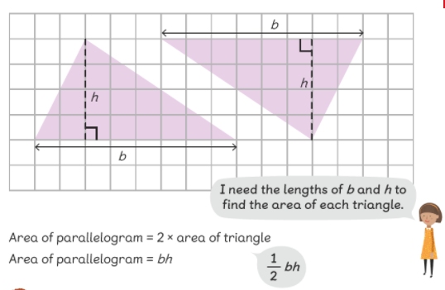
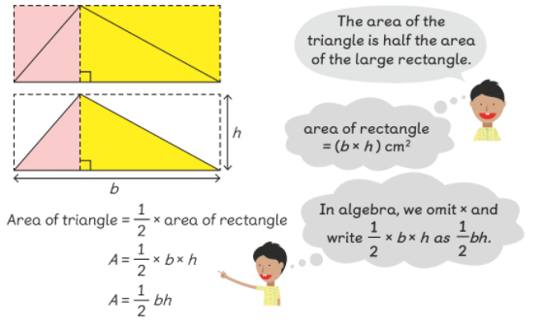
YEAR 6 MATHS KNOWLEDGE ORGANISER
KEY VOCABULARY
AREA AND PERIMETER
PRIOR KNOWLEDGE
Pupils are able to estimate the volume of a cube.
Area (tier 2)
The space occupied by a flat shape.
Pupils can calculate the area and perimeter of rectilinear shapes.
Perimeter (tier 2)
The distance around a two-dimensional shape.
Area of a square and a rectangle is length x width.
Volume (tier 2)
AREA OF A TRIANGLE
The space occupied by a three-dimensional shape
STICKY KNOWLEDGE
Compound(tier 2)
A shape made up of two or more geometric shapes.
We measure volume in cubic measurements.
Cube (tier 3)
Area of a triangle = 1/2 base x height.
A symmetrical three-dimensional shape.
Cuboid (tier 3)
The perimeter of a shape is the total length of the outside of the shape.
A box shape solid object.

Slide 5
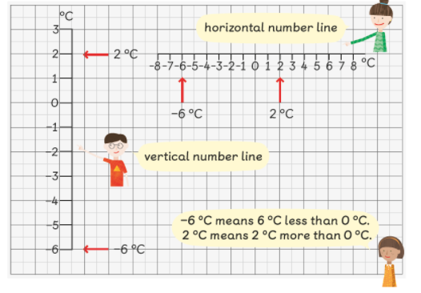
YEAR 6 MATHS KNOWLEDGE ORGANISER
Position and Movement
KEY VOCABULARY
PRIOR KNOWLEDGE
When writing positive co-ordinates, children go along the corridor (x) and up the stairs (y)
Co-ordinate (tier 3)
A group of numbers that indicates the position or point.
Children use mirrors to find lines of symmetry and understand that reflection means the same.
Quadrant
The four quarters of a circle.
The x axis is horizontal and the y axis is vertical.
Reflection
Translation
An image produced as if in a mirror.
STICKY KNOWLEDGE
Translation
The process of moving something from one place to another.
Co-ordinates can use positive and negative numbers but regardless, the x axis co-ordinate is always written first.
Mirror Line
To translate a shape properly, each point must move at an equal distance.
A line in which images are reflected from.
Intervals
When translating a shape, the orientation of the shape does not move. .
A set of real numbers between two given numbers called the endpoints.

Slide 6
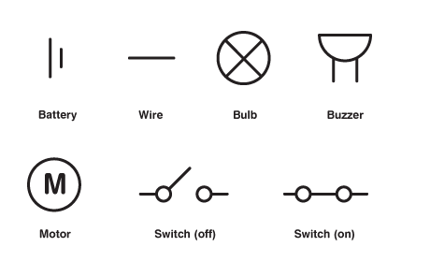
YEAR 6 SCIENCE KNOWLEDGE ORGANISER
KEY VOCABULARY
PRIOR KNOWLEDGE
ELECTRICITY
Circuit
A complete and closed path around which a circulating electric current can flow.
Students know that electricity flows through wires and gives power to our devices and homes.
Cell
A device containing electrodes that is used for generating a current.
Students know that batteries are the source of power within a circuit.
Students know some of the symbols used to represent parts of a circuit diagram.
Conductor
A material or device which allows heat or electricity to carry through.
STICKY KNOWLEDGE
CIRCUIT DIAGRAMS
Current
A flow of electricity which results in ordered directional movement of electrically charged particles.
Electricity is a type of energy and can only flow through a complete circuit.
Voltage
An electrified force that makes electricity move through a wire, measured in volts.
The brightness of a bulb or the volume of a buzzer depends on the number of batteries used in the circuit.
Electricity
A form of energy resulting from the existence of charged particles.
Insulator
An insulator opposes the flow of electricity
Some materials conduct electricity and others do not. They can be categorised into conductors and insulators.
These are the symbols found in circuit diagrams

Slide 7
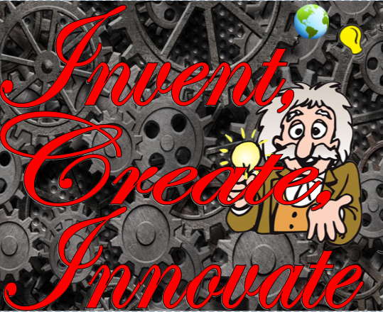
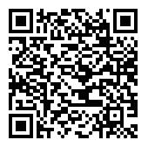
Year 6 Knowledge Organiser – Invent, Create, Innovate Humanities
KEY VOCABULARY
Prior Knowledge
Invention
Making something new that hasn’t been thought about before. The invention of the car changed the world.
I understand the meaning of chronological order and understand how things have changed over time.
I understand the importance of sustainability and how inventions have changed over time to become more sustainable.
Creation
The act of creating or making something to exist/be real. The creation of the famous painting took two years.
STICKY KNOWLEDGE
Innovation
A new idea, product, or way to do something. Using the internet on a mobile phone is thanks to innovations in technology.
Emirati Inventors
Ahmad Al Jabari is a famous Emirati inventor. He designed a device to save water in Mosques when people are using the ablution taps.
Follow the QR code below to learn about some inspiring Emirati inventors.
Device
Invention or machine used to perform simple tasks or something made for a reason.
Amnah Sultan Bin Askoor is a famous Emirati inventor. She has invented a material that stops metal objects from corroding (rusting).
Grid Reference
A map reference indicating a location in terms of a series of vertical and horizontal grid lines identified by numbers or letters.
Expo 2020: Dubai will be a celebration of human brilliance and achievement. It will be an opportunity for people to connect from different corners of the world.
Substance
What something is made from, like the word material. The substance of my shirt is cotton.
Mohammed bin Rashid Al Maktoum is the vice president and prime minister of the United Arab Emirates (UAE) and the ruler of Dubai. He is inspirational as the driving force behind modern Dubai.

Slide 8
Notes:
Slide 1: Only the number can be changed.
Slide 2: Please insert the website link in the homework section.
As for the other slides; everything is editable in accordance to the information that needs to be inputted, but please take into consideration to maintain the same layout or a close one.
This presentation uses the following typographies and colors:
Slide Title : Cairo / Bold Font
Body copy: Cairo/ Regular Font
SRS Orange Colour : #E9721F
Petroleum Colour : # 243D50

