Slide 1
6
CYCLE FOUR 2022

Slide 2
http://year6homework.weebly.com/

Slide 3
YEAR 6 ENGLISH KNOWLEDGE ORGANISER
KEY VOCABULARY
PRIOR KNOWLEDGE
Perilous
Biographies are non fiction which means that the are based on fact. This means biographers need to do research.
Full of danger or risk
Hazardous
Risky; dangerous
When writing in the third person we are writing about someone else (he/ she/ they).
Recognition
To be known for doing something
When writing in chronological order we write in the order that the events happened.
Rigorous
To be extremely careful and thorough
STICKY KNOWLEDGE
The subjunctive form
Expedition
A journey with a purpose
To be extremely interested in something
A biography is a piece of writing that is a true historical piece of writing that tells us about someone’s life.
Fascination
Fraught
Filled with or likely to result in
Active voice means that a sentence has a subject that acts upon its verb.
Endurance
To withstand a difficult task for a long time
Passive voice means that a subject is the recipient of a verb’s action.
Meticulous
Showing a lot of attention to detail
The subjunctive form is used to talk about things that express demands, suggestions or wishes.

Slide 4
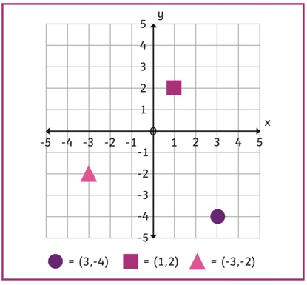
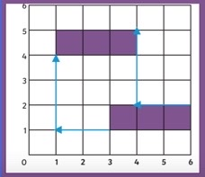
YEAR 6 MATHS KNOWLEDGE ORGANISER
KEY VOCABULARY
Position and Movement
PRIOR KNOWLEDGE
Co-ordinates are separated with a comma and written in between brackets.
Co-ordinate
Each of a group of numbers used to indicate the position of a point, line, or plane.
Co-ordinates are a combination of 2 numbers.
Quadrant
Each of four quarters of a circle.
Translation
X-axis
STICKY KNOWLEDGE
The principal or horizontal axis of a system of coordinates, points along which have a value of zero for all other coordinates.
Co-ordinates can use positive and negative numbers.
Y-axis
The secondary or vertical axis of a system of coordinates, points along which have a value of zero for all other coordinates.
When writing co-ordinates, you always write the x axis followed by the y axis.
Translation
The rectangle has been translated 2 unites left and up 2 units.
The process of moving something from one place to another.
In Maths, translation is a sliding movement.

Slide 5
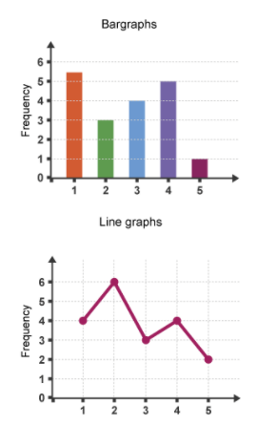
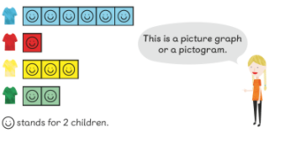
YEAR 6 MATHS KNOWLEDGE ORGANISER Graphs and Averages
KEY VOCABULARY
Prior Knowledge
Types of Graphs
How often something occurs.
To calculate the mean, you must add up all of the numbers in a given data set and divide the total by the number of digits.
Frequency
Data represented using 2D columns.
Bar Chart
Dividing the total value by the number of values.
Information given in a table can be represented as a graph.
Average
You are able to read information on a line graph and develop questions based off this.
Continuous
Data
Data that can take any value.
STICKY KNOWLEDGE
Something different or abnormal.
Anomaly
The arithmetic average in a set of given numbers.
Sticky Knowledge
Mean
Sticky Knowledge 1
We can use bar graphs to show the relative sizes of many things, such as what type of car people have
The middle number of a given set of numbers.
Median
The most common number
Sticky Knowledge 2
Mode
One mile is equal to 1.6 kilometers.

Slide 6
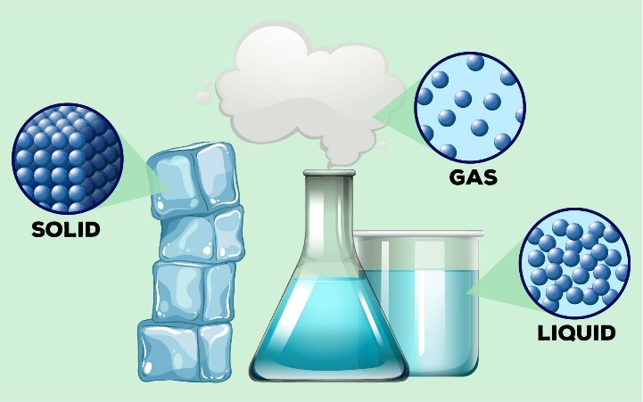
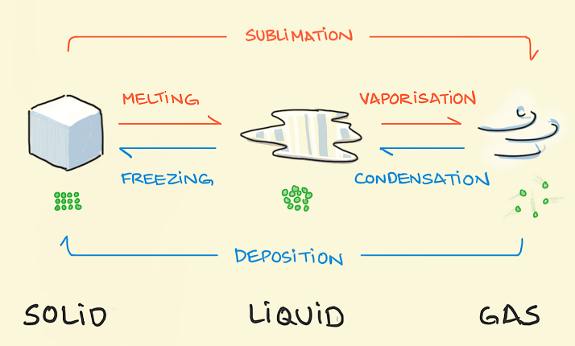
YEAR 6 SCIENCE KNOWLEDGE ORGANISER
KEY VOCABULARY
STATES OF MATTER
PRIOR KNOWLEDGE
Molecules
A group of atoms bonded together. Representing the smallest fundamental unit of a chemical compound.
Students can explain what the difference is between a solid, liquid and gas and name examples.
Density
An object’s density is its mass per unit volume. Essentially, how heavy or tightly packed something is.
Students understand that examples of changes of state happen all around us, particularly involving temperature.
Students have an understanding of what makes a reversible and irreversible change.
Evaporation
When a liquid is heated, it can turn into a gas.
STICKY KNOWLEDGE
Condensation
When a gas cools down, it can become a liquid. You usually find it on windows.
CHANGES OF STATE
Some materials will dissolve in liquid to form a solution. Using evaporation, we can recover these materials.
Melting
When heat is applied to certain solids, they can melt and become liquids.
The molecules in a Solid are tightly packed together. In a liquid they are looser but still dense, and in a gas they are free-flowing.
Reversible
A change of state that can be reversed. (i.e. water into ice)
There are two types of changes, a chemical change and a physical change. Chemical changes produce new compounds.
Chemical reaction
A chemical reaction between two compounds which can form something new.
In extreme cases, Solids can turn straight into gases and gases can turn instantly into solids.

Slide 7
Notes:
Slide 1: Only the number can be changed.
Slide 2: Please insert the website link in the homework section.
As for the other slides; everything is editable in accordance to the information that needs to be inputted, but please take into consideration to maintain the same layout or a close one.
This presentation uses the following typographies and colors:
Slide Title : Cairo / Bold Font
Body copy: Cairo/ Regular Font
SRS Orange Colour : #E9721F
Petroleum Colour : # 243D50

